Slide 1
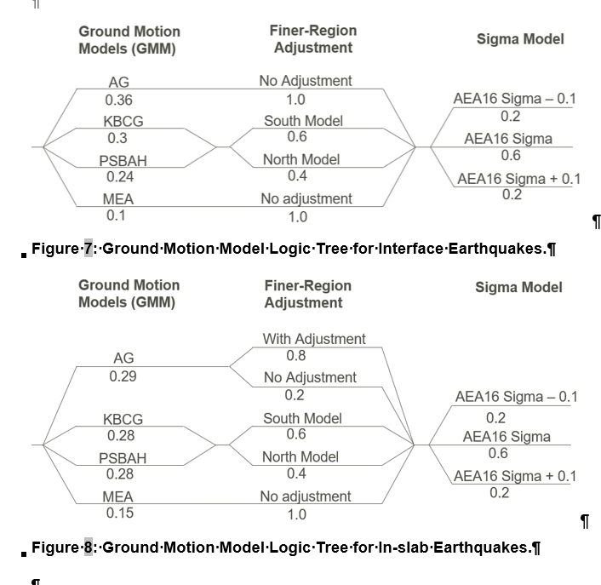
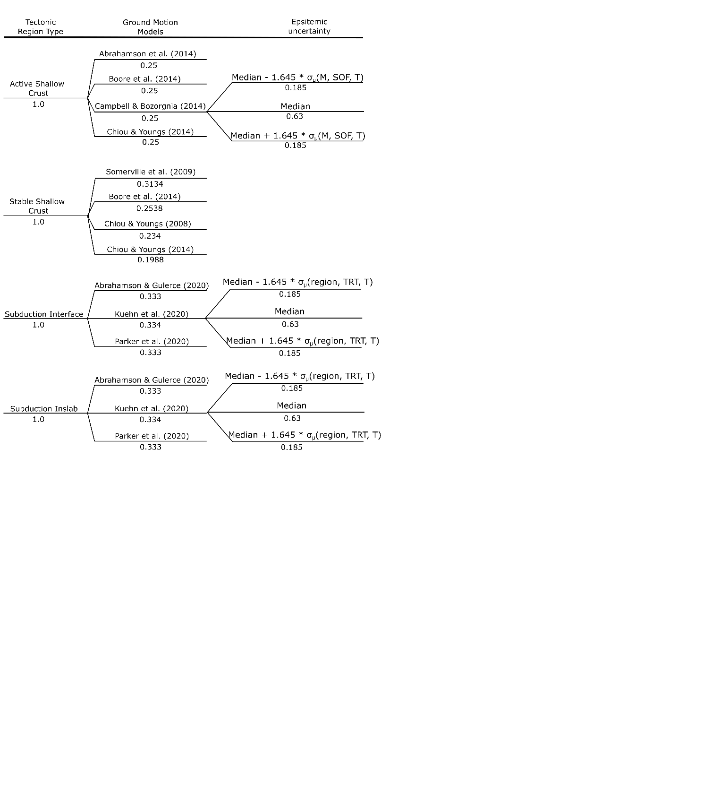
Fractiles have between GMM and within GMM uncertainty
Fractiles are ONLY from between GMM uncertainty
Option 2
Option 1
Global coefficients
Within GMM uncertainty is NGA-Sub as published for each model
Total sigma is as published for each model
Add Montalva. Weight the 4 GMMs as follows:
AG = 0.36
Kuehn = 0.3
Parker = 0.24
Montalva = 0.1
Note that we need to implement and test this bespoke version in OQ v3.16 (I think we did this for QB)

Slide 2
Highest accelerations: Regional coefficients (what we’ve done before)
Narrow fractiles
Medium accel: Both Regional & Global Coeff
Moderate fractiles – probably oddly shaped because of fixed v. period dependent sigma models
In-slab: Regional v. Global → 50-50 weighting
Interface: Regional (80%) vs. Global (20%)
Lower accel: Global coefficients
Broad fractiles

